Slide 1


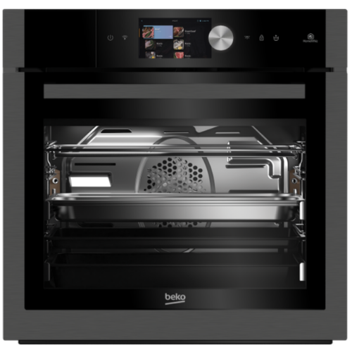









BUILT-IN OVEN
RRP
Our Price
: €________
: €________
MODEL: BIDM19700DXDS
20 Oven functions
Static Cooking
Fan Cooking
Static+Fan
Fan Defrost
Fan Grilling
Half Grill
Assisted Static+Fan
Steam Baking
3D cooking
Warm keeping
Bottom Heating
Eco Fan
Steam Shine Cleaning
Fan Heating
Half Grill + Fan
Full Grill
Slow cooking
Eco cooking
H 59.5 x W 59.4 x D 56.7 cm
Design
Dark Inox finish
Halogen interior lighting
TFT Display
5-Level side racks
Touch control
Key Features
Performance & Consumption
SteamShine®
71 litre main cavity
5 Level side racks
Energy rating: A
Total electric power – 3100W
Voltage – 220 – 240 V
Frequency – 50 Hz
21257345/6/7
Triple A, St. Thomas Street, Luqa
Find us on
triplealuqa@gmail.com
www.triplealuqa.com

